Slide 1
Twelve Years To Go
The Christian Home Series
Sermon #8
Greg Gay

Slide 2
Once Upon A Time…God created man
Adam and Eve in the Garden (Adam, Gen 2:7, Eve, Gen 2:21)
Created as Adults
Declared to be: One Flesh (married)
Gen 2:24 Therefore a man shall leave his father and mother and be joined to his wife, and they shall become one flesh.
Adam and Eve were living beings capable of reproduction to create additional human beings, thus perpetuating the human species.

Slide 3
Life at conception
Humans, once conceived, will never cease to exist.
All humans after Adam and Eve are born of a woman in the process of birth.
An unborn child (brephos) is a human being, just as a newborn baby (brephos) is a human being:
Elizabeth: John the Baptist - not yet born. Visit from Mary:
Luke 1:4 And it happened, when Elizabeth heard the greeting of Mary, that the babe leaped in her womb
Mary: mother of Jesus – just born: Luke 2:16 And they [shepherds] came with haste and found Mary and Joseph, and the Babe lying in a manger.
We see from these passages that God honors the babies not yet born just as he honors newborn babies.

Slide 4
Each child is a person formed by God
Ps 139:13-16 NIV
13 For you created my inmost being; you knit me together in my mother's womb.
14 I praise you because I am fearfully and wonderfully made; your works are wonderful, I know that full well.
15 My frame was not hidden from you when I was made in the secret place.
When I was woven together in the depths of the earth, 16 your eyes saw my unformed body.
All the days ordained for me were written in your book before one of them came to be.

Slide 5
A Baby: Every Child deserves to be wanted, cherished as a gift from God, and allowed to be born
Ps 127:3 Behold, children are a heritage from the Lord, The fruit of the womb is a reward.
President Ronald Reagan in a 1983 speech on abortion: “Malcolm Muggeridge, the English writer, goes right to the heart of the matter: "Either life is always and in all circumstances sacred, or intrinsically of no account; it is inconceivable that it should be in some cases the one, and in some the other." The sanctity of innocent human life is a principle that Congress should proclaim at every opportunity.”
Not just congress
Notes:
https://patriotpost.us/documents/84

Slide 6
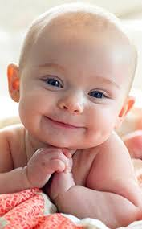
More eternal than the ocean
“If one feels the need of something grand, something infinite, something that makes one feel aware of God, one need not go far to find it. I think that I see something deeper, more infinite, more eternal than the ocean in the expression of the eyes of a little baby when it wakes in the morning and coos or laughs because it sees the sun shining on its cradle. Vincent Van Gogh
Notes:
https://www.goodreads.com/quotes/148634-if-one-feels-the-need-of-something-grand-something-infinite
https://www.pinterest.com/pin/489344315745688911/

Slide 7
A Baby: When a child is born, it is a wonderful occasion, and is intended to be a cause for celebration!
John 16:21
21 A woman, when she is in labor, has sorrow because her hour has come; but as soon as she has given birth to the child, she no longer remembers the anguish, for joy that a human being has been born into the world.

Slide 8
A Baby
Cicero: “Of all nature’s gifts to the human race, what is sweeter to a man than his children?”
“It sometimes happens, even in the best of families, that a baby is born. This is not necessarily cause for alarm. The important thing is to keep your wits about you and borrow some money.” Elinor Goulding Smith quoted in, In Praise of Babies, 1968

Slide 9
A Baby: $’s invested in children’s raising:
On average, middle-income parents will spend $284,570 by the time a child turns 18 [2020 $’s]
Only money?
Hopefully, we realize that having children is far more than a function of money.
Hopefully, we are willing to invest our whole hearts in the goal of presenting a child to God!
Bible example: Hannah, Samuel’s mother 1 Sam 1:8 “I will give him to the Lord all the days of his life…”
Notes:
https://www.investopedia.com/articles/personal-finance/090415/cost-raising-child-america.asp
TIM PARKER
Updated May 5, 2020

Slide 10
Twelve Years To Go
The True Story of Hezekiah, Hephzibah, and Manasseh
2 Kings 21:1 Manasseh was twelve years old when he became king, and he reigned fifty-five years in Jerusalem [over Judah]. His mother’s name was Hephzibah.

Slide 11
We meet Hezekiah, King of Judah:
2 Kings 20: 1 - 6 1 In those days Hezekiah was sick and near death. And Isaiah the prophet, the son of Amoz, went to him and said to him, "Thus says the Lord: 'Set your house in order, for you shall die, and not live.' " 2 Then he turned his face toward the wall, and prayed to the Lord, saying, 3 "Remember now, O Lord, I pray, how I have walked before You in truth and with a loyal heart, and have done what was good in Your sight." And Hezekiah wept bitterly. 4 And it happened, before Isaiah had gone out into the middle court, that the word of the Lord came to him, saying, 5 "Return and tell Hezekiah the leader of My people, 'Thus says the Lord, the God of David your father: "I have heard your prayer, I have seen your tears; surely I will heal you. On the third day you shall go up to the house of the Lord. 6 And I will add to your days fifteen years.

Slide 12
15 years of guaranteed life!
3 years into this promise, Hezekiah and his wife, Hephzibah have a son, their only child, Manasseh.
Now, for Hezekiah, there is Twelve Years To Go!
12 years left for Hezekiah to be with his wife Hephzibah.
12 years left for Hezekiah and Hephzibah as parents to raise their son, before the remaining years are left up to Hephzibah by herself.

Slide 13
And so it begins… Is a child a blank slate?
Notes:
A child is a blank slate
Nature versus Nurture discussions

Slide 14
A Blank Slate?
Nature refers to all of the genes and hereditary factors that influence who we are—from our physical appearance to our personality characteristics.
Nurture refers to all the environmental variables that impact who we are, including our early childhood experiences, how we were raised, our social relationships, and our surrounding culture.
Sooooo, is there nothing we can do about either one?
My presumption: Nature is not controlled by us. Nurture is learned through the culture in which we interact.
Notes:
https://www.verywellmind.com/what-is-nature-versus-nurture-2795392

Slide 15
Choices and Chance = no guarantees in life
Eccl 9:11 I returned and saw under the sun that —
The race is not to the swift, [the fastest does not always win the race]
Nor the battle to the strong, [the strongest does not always win the battle]
Nor bread to the wise, [the wisest does not always have plenty]
Nor riches to men of understanding, [the shrewdest are not always rich]
Nor favor to men of skill; [best jobs & appreciation not always for the most skillful]
But time and chance happen to them all.

Slide 16
Free Will – Life’s choices set before us
Deut 30:15-20 Moses to Israel: 15 "See, I have set before you today life and good, death and evil… I call heaven and earth as witnesses today against you, that I have set before you life and death, blessing and cursing; therefore choose life, that both you and your descendants may live; 20 that you may love the Lord your God, that you may obey His voice, and that you may cling to Him, for He is your life and the length of your days; and that you may dwell in the land which the Lord swore to your fathers, to Abraham, Isaac, and Jacob, to give them."
Josh 24:14-15 Joshua to Israel: 14 "Now therefore, fear the Lord, serve Him in sincerity and in truth, and put away the gods which your fathers served on the other side of the River and in Egypt. Serve the Lord! 15 And if it seems evil to you to serve the Lord, choose for yourselves this day whom you will serve, whether the gods which your fathers served that were on the other side of the River, or the gods of the Amorites, in whose land you dwell. But as for me and my house, we will serve the Lord."

Slide 17
What do we want to “set before” our children?
Everything good, of course!
What do we want them to “choose?”
Only wonderful choices, of course!

Slide 18
76 Parents & Educators:
“What’s The Most Important Value To Teach Your Children?”
And, “if you could only teach your kids 3 values, what would they be?”
Notes:
Tom Raider: https://blog.yellowoctopus.com.au/

Slide 19
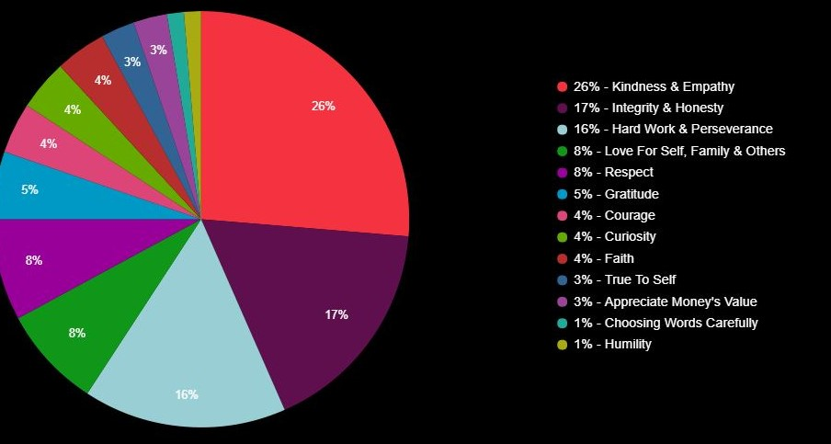
Notes:
Most important value 1 from each person

Slide 20
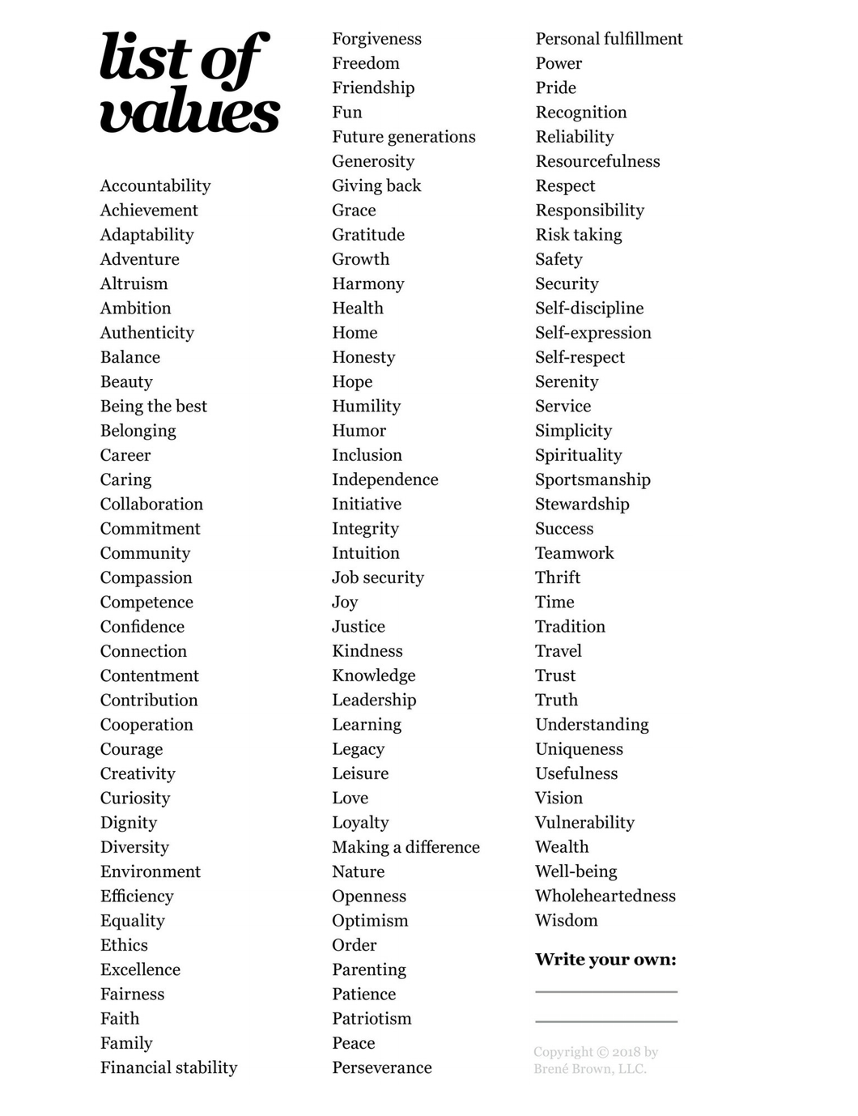
Values to teach our children:
Notes:
A value driven life
blog.alexmaccaw.com

Slide 21
We want them to learn spiritual values:
Faith
Love
Mercy
Kindness
Gentleness
Goodness
Hope
Compassion
Notes:
https://www.google.com/imgres?imgurl=https%3A%2F%2Fliveboldandbloom.com%2Fwp-content%2Fuploads%2F2015%2F05%2Fscreenshot-pdf-download-list-of-values.jpg&imgrefurl=https%3A%2F%2Fliveboldandbloom.com%2F05%2Fvalues%2Flist-of-values&tbnid=spiFlTEUsia1PM&vet=10CFYQMyiPAWoXChMIsKCh38qn6gIVAAAAAB0AAAAAEAg..i&docid=nTdA-SmAoS1UYM&w=825&h=672&q=spiritual%20values%20list&ved=0CFYQMyiPAWoXChMIsKCh38qn6gIVAAAAAB0AAAAAEAg

Slide 22
So….. I just read all those words. Does that mean everyone has now learned these values and they are an important part of their life?
Just saying words is not how values are taught.
Values are learned throughout the life cycle. In early childhood value learning is influenced by a process of interpersonal identification with the parents. Parents’ behavior toward each other and interaction with children represents certain values by explicit or implicit way. Parents tell children what is right and what is wrong, but also give example of the behavior directed to solve everyday problems. Children acquire the values of the particular gender (boys learn how to behave as boys and girls learn how to behave as girls),... Dmitry Podolskiy, Encyclopedia of the Sciences of Learning
“Don’t say it if you’re not going to live it. And if you’re going to live it, you don’t have to say it anyway.” ― Craig D. Lounsbrough
“value” of the day: example: humor
Notes:
Encyclopedia of the Sciences of Learning https://link.springer.com/referenceworkentry/10.1007%2F978-1-4419-1428-6_1112#:~:text=Values%20are%20learned%20throughout%20the,by%20explicit%20or%20implicit%20way.
https://www.goodreads.com/quotes/tag/morals?page=5 Lounsbrough quote

Slide 23
Don’t say it if you are not going to live it:
Life gives many teaching moments,
Identify and discuss how it went,
Repeat
When?
Yes, always

Slide 24
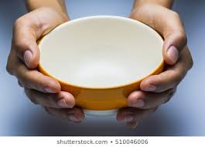
Teaching Children – like Mongolian BBQ
Start with
a bowl (child)
Notes:
If this represents “nature” it is an amazing bowl, made by God’s design.

Slide 25
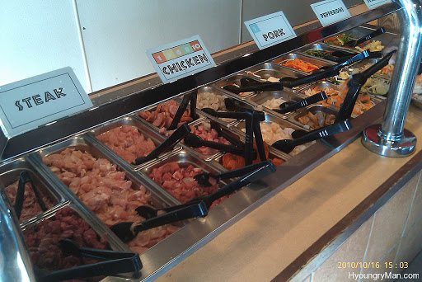
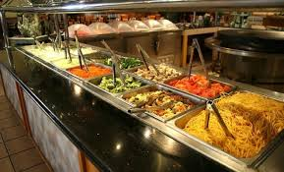
Add ingredients (values)
Notes:
So many choices!

Slide 26
Everything is important
Notes:
We want to add everything, but the bowl only holds so much!

Slide 27
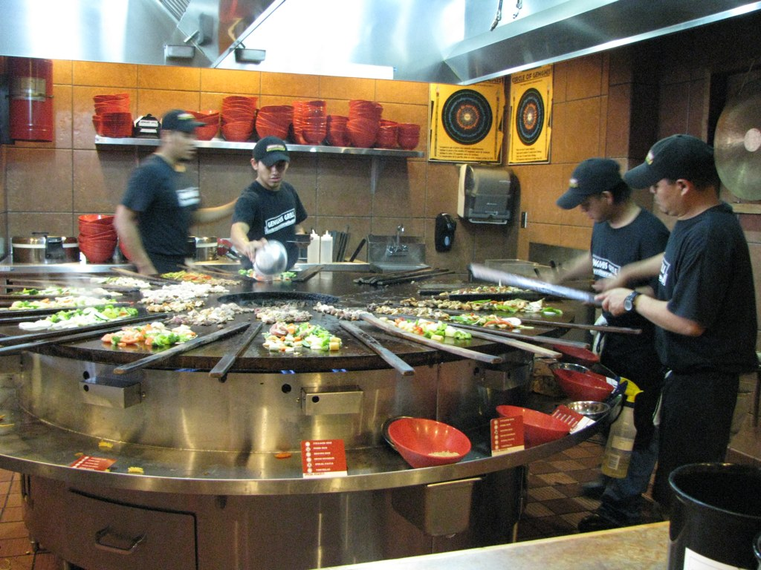
Cook to combine everything (Life)

Slide 28
How did it turn out? Who is this person?
Notes:
Each bowl is different

Slide 29
If parents want to increase the odds of success for our children:
Get married (man with woman, 1 Cor. 7:2)
Stay married
Be who you are supposed to be in your marriage (a Christian)
Carefully select what you do, where you go and who you spend time with, especially with your children.
Notes:
Source – next few slides

Slide 30
What is a family?
Notes:
https://www.pewsocialtrends.org/2018/04/25/the-changing-profile-of-unmarried-parents/

Slide 31
Nonmarital births – effect on children
Information is from NON-religious source:
The National Center for Biotechnology Information
PubMed Central® (PMC) is a free full-text archive of biomedical and life sciences journal literature at the U.S. National Institutes of Health's National Library of Medicine (NIH/NLM).
Paper: Family Structure Experiences and Child Socioemotional Development During the First Nine Years of Life: Examining Heterogeneity by Family Structure at Birth
Sharon H. Bzostek - Department of Sociology and Institute for Health, Health Care Policy and Aging Research, Rutgers, The State University of New Jersey, New Brunswick, NJ, USA
Lawrence M. Berger - Institute for Research on Poverty and School of Social Work, University of Wisconsin–Madison, Madison, WI, USA
Notes:
https://www.ncbi.nlm.nih.gov/pmc/articles/PMC5948107/

Slide 32
Nonmarital births – effect on children
Selection into family structure at birth is important. Approximately 43 % of all births to American women under age 40 are nonmarital (Manning et al. 2015). Whereas nearly 60 % of these births are to cohabiting couples (Manning et al. 2015), cohabiting unions are strikingly unstable in the United States, and most will eventually dissolve, many within the first few years of the birth (Andersson 2002).
Girls growing up in a single-mother family have been shown to be more likely to become a single parent themselves (Hofferth and Goldscheider 2010). Nonmarital births in the United States are also disproportionately common among socioeconomically disadvantaged groups (Manning et al. 2015).

Slide 33
Nonmarital births – effect on children
The individuals who are most likely to experience a nonmarital birth are also most likely to experience limited economic resources, economic instability, family structure instability, and lower-quality family relationships, each of which is associated with adverse developmental outcomes for children (McLanahan 2004; McLanahan and Jacobsen 2015; McLanahan and Percheski 2008; McLoyd 1990), independent of parental marital status at birth.
Associations between family structure experiences and child outcomes tend to be attenuated considerably when researchers adjust for selection factors. The most rigorous studies have tended to leverage within-child variation to rule out unobserved time-invariant factors, which further attenuates, but does not eliminate, these associations (see McLanahan et al. 2013).
Notes:
https://www.ncbi.nlm.nih.gov/pmc/articles/PMC5948107/

Slide 34
Increase odds of success: repeated:
Get married (man with woman, 1 Cor. 7:2)
Stay married
Be who you are supposed to be in your marriage (a Christian)
Carefully select what you do, where you go and who you spend time with, especially with your children.

Slide 35
Children are in school the moment they are born
Mother, Father, Siblings, Grandparents, Friends, Church
Harvard University: Center on the Developing Child: Brains are built over time, from the bottom up. The basic architecture of the brain is constructed through an ongoing process that begins before birth and continues into adulthood. Simpler neural connections and skills form first, followed by more complex circuits and skills. In the first few years of life, more than 1 million new neural connections form every second.
Notes:
https://developingchild.harvard.edu/science/key-concepts/brain-architecture/ Center on the Developing Child at Harvard University

Slide 36
A Baby’s Brain:
Frank Graff reports: Although our genes dictate how brain connections form, experience activates the connection. For example, the circuits that enable language and vision can only be properly formed when a baby hears and sees stimulating action.
A baby’s brain in the first three months focuses on neural connections that enable seeing and hearing. After mastering that, the brain focuses more on language and speech production. Around the one year mark, the brain turns to higher cognitive functions. But higher-level brain function depends on the quality of lower-level circuits formed soon after birth. Babies need stimulating and responsive interactions to develop those lower-level circuits.
Notes:
http://science.unctv.org/content/reportersblog/babies-neural-connections

Slide 37
Children learn:
How a mother interacts with a father
How a father interacts with a mother
How a wife interacts with a husband
How a husband interacts with his wife
They learn what it looks like to be a wife, husband
They learn what to expect, how they will be treated as a wife, husband

Slide 38
Children learn from the primary activities of parents to form role expectations
From the Garden:
Man – focus on earning, providing
Woman – focus on bearing, caring
Gen 3:16-19 16 To the woman He said: "I will greatly multiply your sorrow and your conception; In pain you shall bring forth children; Your desire shall be for your husband, And he shall rule over you."
17 Then to Adam He said, "Because you have heeded the voice of your wife, and have eaten from the tree of which I commanded you, saying, 'You shall not eat of it’: "Cursed is the ground for your sake; In toil you shall eat of it All the days of your life. 18 Both thorns and thistles it shall bring forth for you, And you shall eat the herb of the field. 19 In the sweat of your face you shall eat bread

Slide 39
Needs of a Child – from Growing Kids God’s Way
Loved
Where he or she belongs in the family, in mom and dad’s life
That mommy and daddy love each other

Slide 40
Formal Education: Home / Public?
Yes
Talk to some educators among us – we have some amazing men and women who serve their community in public schools.
Talk to some who believe that home schooling is best.
My observations:
Home school is not a guarantee of success
Public school is not a guarantee of failure
Parental involvement greatly increases the odds of success for any education process, whether schooled at home or at school.

Slide 41
The Scriptures, Always:
We can find at least 1,700 scriptures that directly mention or refer to children. Still, parents are left wondering what is best?
The Bible, in this area gives some broad outlines that have to be filled in with painstaking daily decisions. Prov 22:6 Train up a child in the way he should go, And when he is old he will not depart from it.
We can know the values we want to end up with in our children, but not necessarily how to get there the best way.
There are resources…

Slide 42
Resources: Growing Kids God’s Way (not inspired)
Growing Kids God’s Way – Information: The Three Assumptions of Revealed Truth
“Although the Bible provides moral ideals, it does not provide parents with the exact how-to’s for parenting. It offers clues to child training but not a detailed blueprint that speaks to every action. Those facts are relevant to this presentation and the formation of our thoughts. All our curricula is guided by three basic assumptions.
“First: The first assumption relates to the goal of parenting. It is to create a Life-giving home environment, in which children can thrive spiritually, morally and emotionally. Creating and sustaining a life-giving home environment is not something one adds to their everyday parenting routine, like adding seasoning to a bland dish. Rather, it is a cultivated lifestyle of choice.
“For clarity sake, this is how we define the concept: A Life-Giving home environment is a lifestyle, cultivated by parents, that promotes the life-giving character of God, while actively avoiding language, attitudes and behaviors that assault or detract from God’s character. Therefore, what is it that God requires of us? “He has shown you O man what is good. And what does the Lord require of you, but to do justly, to love mercy, and to walk humbly with your God?” (Micah 6:8).
Notes:
https://growingfamilies.life/about-us

Slide 43
Resources, continued
Growing Kids God’s Way
The Three Assumptions of Revealed Truth, continued
“Second: The Bible, although sufficient and authoritative, is not comprehensive. That is, it does not speak [specifically] to every situation parents face during the day. It provides moral principles governing godly living but does not specifically lay out the how-to’s of training. This is where wisdom, experience, failures and success comes. It is also where a healthy community of parents play a big role. The Growing Families community is that type of community! Life-giving and helpful.

Slide 44
Resources, continued
Growing Kids God’s Way
The Three Assumptions of Revealed Truth, continued
“Third: The third assumption is based on the relationship of the first two. Since the goal of parenting is to produce a morally responsible and biblically responsive children, and since the Bible is not specific on how to accomplish that goal, we believe that all child-training principles, practices, methods, and theories should meet two important criteria:
a. They must advance the righteous goal of raising children (Ephesians 6:4).
b. They must be compatible with the scope of God’s Character. In contrast, any theory that detracts from, is antagonistic to, or restricts or seeks to undermine Scriptural intent, by creating contrary prohibitions and assertions will be inadequate and fall short. The methods of training must advance and compliment God’s Character.
The Growing Families’ curriculum content, is guided by the two criteria above.

Slide 45
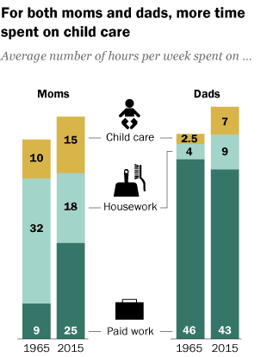
Time with Children/at home??
Should be the best teacher of all!
“Care” time cannot be all
intensive 1 to 1 time
Parents have things to do too
Learning to “help,” or to play quietly by
themselves is also valuable for a child to
learn at an early age
Always working late and on weekends
for either parent really limits the
amount of time that can be spent
with children & hurts family routines
Notes:
Pew Research Center 2015 data. Paid work includes commute time

Slide 46
How to spell…
“It was Dr. Anthony P. Witham who once said “children spell love…T-I-M-E.”
Notes:
https://www.lifehack.org/articles/featured/5-ways-to-spend-time-with-your-kids-when-you-have-no-time.html

Slide 47
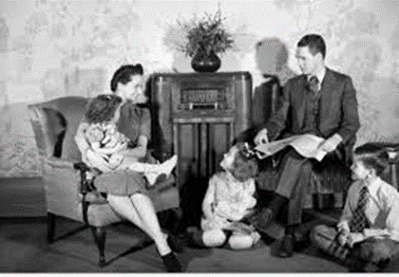
Gathered around – Radio 20’s, 30’s, 40’s, etc
History of Radio: Radio broadcasting was the cheapest form of entertainment, and it provided the public with far better entertainment than most people were accustomed to. As a result, its popularity grew rapidly in the late 1920s and early 1930s, and by 1934, 60 percent of the nation’s households had radios.
Encyclopaedia Britannica: Soap operas such as Ma Perkins and The Guiding Light kept housewives company through the afternoon. Children listened to the adventure series Little Orphan Annie and the science-fiction show Flash Gordon. Amos ’n’ Andy, a situation comedy, was the most popular show ever broadcast, lasting more than 30 years. The Shadow, a crime drama, also had a loyal following…In 1938 [Orson] Welles’s radio adaptation of H.G. Wells’s science-fiction tale The War of the Worlds created panic when listeners failed to hear the disclaimer and believed Martians actually were invading Earth.
Notes:
https://eh.net/encyclopedia/the-history-of-the-radio-industry-in-the-united-states-to-1940/#:~:text=Radio%20broadcasting%20was%20the%20cheapest,the%20nation%27s%20households%20had%20radios.
https://www.britannica.com/topic/Golden-Age-of-American-radio

Slide 48
Gathered around - Television
1990’s Grolier Encyclopedia:
Few inventions have had as much effect on contemporary American society as television. Before 1947 the number of U.S. homes with television sets could be measured in the thousands. By the late 1990s, 98 percent of U.S. homes had at least one television set, and those sets were on for an average of more than seven hours a day. The typical American spends (depending on the survey and the time of year) from two-and-a-half to almost five hours a day watching television.
Notes:
https://www.nyu.edu/classes/stephens/History%20of%20Television%20page.htm

Slide 49
Gathered Around - Today
Radio: same room
TV: same room (till recent decades)
Online Devices: easy to scatter = much less time together as a family.

Slide 50
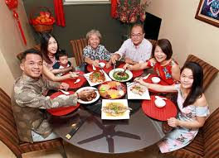
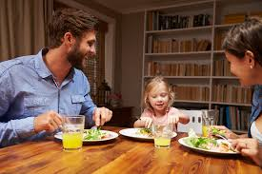
Together activities can include: Eating

Slide 51
Games, Reading, Play

Slide 52
Time with each other
Has to be planned, even scheduled with our frantic schedules
What is that going to look like for our family?
It may be that we watch TV – but we are there together
It may be that we are on our devices – but we are there together
Can we eat even one meal a day – together?
Maybe we can have a pizza and movie night once a week as a family?
Can bedtime be a story time & prayer time – together?

Slide 53
Time with others
Has to be planned!
What does hospitality look like?
When do we see Church members? Remember we teach values by our actions more than our words. Hopefully, we are eager to worship every time the doors open no matter our children’s ages!
Neighbors
Work friends
How do we, as a family, have influence in our world?
If we only cocoon, we never have influence

Slide 54
What are we willing to sacrifice for our children?
Job 1:5 So it was, when the days of feasting had run their course, that Job would send and sanctify them, and he would rise early in the morning and offer burnt offerings according to the number of them all. For Job said, “It may be that my sons have sinned and cursed God in their hearts.” Thus Job did regularly.
Are parents willing to sacrifice hobbies for their children? Can parents do without a hobby if their children cannot participate? Time with “the guys,” “the girls,” Every Saturday golf, etc., etc.
That does not mean NO time for ourselves, it DOES mean we sacrifice for our children where it matters most! Time. What about family golf? What about family fishing? What about family, family, family…
2 Cor 12:14 “…For the children ought not to lay up [save up ESV] for the parents, but the parents for the children.”
Notes:
My dad loved quartet singing. He loved rodeos. We went to a lot in my growing up years. We went together. While either was fine, neither is something I have a passion for today. But, we were there together.
One of my passions is books. For years I did not pass a thrift store or a used book store without stopping, as my kids well know. Those are not their passions today, but they bring up those days often when reminiscing about their childhood days.

Slide 55
However, Children are not God.
They are a great priority, but not more important than our relationship with
God, Spouse, Marriage
Issues: when a child is born, their schedule may undermine all other priorities – worship, marriage, and more if the parents are not very careful and aware.
Extreme example: Baby asleep? Can’t attend worship?

Slide 56
Verses to help understand parents’ obligations:
Ephesians 6:1-2 1 Children, obey your parents in the Lord, for this is right. 2 “Honor your father and mother,” which is the first commandment with promise:
This is God’s Pattern for children.
Parents (Father & Mother) who are “in the Lord” raising
Children who “obey and honor.”
Proverbs 1:8 ESV Hear, my son, your father's instruction, and forsake not your mother's teaching

Slide 57
Bible Description of Mothers with their children
1 Thess 2:7 Amplified
But we behaved gently when we were among you, like a devoted mother nursing and cherishing her own children
Gently
Devoted
Nursing
Cherishing

Slide 58
Bible Description of Fathers With Their Children
1 Thess 2:11 NIV For you know that we dealt with each of you as a father deals with his own children, encouraging, comforting and urging you to live lives worthy of God, who calls you into his kingdom and glory.
Encouraging
Comforting
Urging

Slide 59
The Art of Parenthood (Generally speaking…)
“Our children are watching us live, and what we are shouts louder than anything we can say. When we encircle them with love they will be loving. When we are thankful for life’s blessings they will be thankful. When we express friendliness they will be friendly. When we speak words of praise they will praise others. When we set an example of honesty our children will be honest. When we practice tolerance they will be tolerant. When we confront misfortune with a gallant spirit, they will earn to live bravely. When our lies affirm our faith in the enduring values of life they will rise above doubt and skepticism. We can’t stand there pointing our finger to the heights we want our children to scale. We must start climbing, and they will follow” Wilferd A Peterson

Slide 60
Discipline of a Child – is part of loving a child
Hebrews 12:3-8 (NKJV) 3 For consider Him who endured such hostility from sinners against Himself, lest you become weary and discouraged in your souls. 4 You have not yet resisted to bloodshed, striving against sin. 5 And you have forgotten the exhortation which speaks to you as to sons: “My son, do not despise the chastening of the Lord, Nor be discouraged when you are rebuked by Him; 6 For whom the Lord loves He chastens, And scourges every son whom He receives.” 7 If you endure chastening, God deals with you as with sons; for what son is there whom a father does not chasten? 8 But if you are without chastening, of which all have become partakers, then you are illegitimate and not sons.

Slide 61
Discipline of a Child
Discipline means: training that corrects, molds, or perfects the mental faculties or moral character. Discipline includes punishment.
Punish means: to impose a penalty on for a fault, offense, or violation.
Proverbs 13:24 He who spares his rod hates his son, But he who loves him disciplines him promptly.
This does not mean a child is severely beaten: Psalm 23:4 …Your rod and Your staff, they comfort me.

Slide 62
Discipline is not an option – how to discipline is
1 Sam 3:13 – Eli did not restrain his children: 1 Sam 3:13 For I have told him that I will judge his house forever for the iniquity which he knows, because his sons made themselves vile, and he did not restrain them.
Ephesians 6:4 And you, fathers, do not provoke your children to wrath, but bring them up in the training and admonition of the Lord.
Colossians 3:21 Fathers, do not provoke your children, lest they become discouraged.
Proverbs 22:6 Train up a child in the way he should go, And when he is old he will not depart from it. (according to his/her way)
Never in anger
Never because a parent is stronger than their child.
Only as is fitting for the problem. Not extreme, not abusive.

Slide 63
Loving our children includes teaching them meaningful tasks: Age-Appropriate Chores for Children. From the beginning Adam and Eve “kept” the garden
Age-Appropriate Chores for Children
Your child may be able to do more than you think. "Keep in mind that a child who has mastered a complicated computer game can easily run the dishwasher," Dr. Elizabeth Pantley says.
In general, she says, preschoolers can handle one or two simple one-step or two-step jobs. Older children can manage more. Here are her pointers on kids' chores by age:
Notes:
Web MD site: Elizabeth Pantley,

Slide 64
Meaningful Tasks to contribute and to have a sense of pride in accomplishment:
Ages 4-5
Any of the above chores, plus:
Make their bed
Empty wastebaskets
Bring in mail or newspaper
Clear table
Pull weeds, if you have a garden
Use hand-held vacuum to pick up crumbs
Water flowers
Unload utensils from dishwasher
Wash plastic dishes at sink
Fix bowl of cereal
Ages 2-3
Put toys away
Fill pet's food dish
Put clothes in hamper
Wipe up spills
Dust
Pile books and magazines

Slide 65
Chores for children ages
Ages 6-7
Any of the above chores, plus:
Sort laundry
Sweep floors
Set and clear table
Help make and pack lunch
Weed and rake leaves
Keep bedroom tidy
Ages 8-9
Load dishwasher
Put away groceries
Vacuum
Help make dinner
Make own snacks
Wash table after meals
Put away own laundry
Sew buttons
Make own breakfast
Peel vegetables
Cook simple foods, such as toast
Mop floor
Take pet for a walk

Slide 66
Chores for children ages 10 and older.
Any of the above chores, plus:
Unload dishwasher
Fold laundry
Clean bathroom
Wash windows
Wash car
Cook simple meal with supervision
Iron clothes
Do laundry
Baby-sit younger siblings (with adult in the home)
Clean kitchen
Change their bed sheets

Slide 67
How do we introduce our children to God
Show them God’s attributes in our own lives:
Example: Eph. 4: 32 And be kind to one another, tenderhearted, forgiving one another, even as God in Christ forgave you.
This starts at home and is tested every day. Our children will always be watching to see how we do.
Remember the Growing Kid’s God’s Way three basic needs of every child?
To be loved
To know where they fit / belong
To know their parents love each other
Everything in the home is filtered through those needs for a child

Slide 68
What Happened to Manasseh?
2 Kings 21: 1-2 1 Manasseh was twelve years old when he became king, and he reigned fifty-five years in Jerusalem. His mother’s name was Hephzibah. 2 And he did evil in the sight of the Lord, according to the abominations of the nations whom the Lord had cast out before the children of Israel.
When he was 67 years old, he was captured by the Assyrians and carried to Babylon (2 Chron. 33). While there, he repented and was allowed to return to Jerusalem where he tried to undo all the evil of his 55 year reign. He was unable to accomplish that completely. When he died, he was not buried with the Kings, even though he reigned longer than any of them.

Slide 69
Twelve years. Twelve very important years!
The years before six are the most important in establishing attitudes and habit patterns which will last throughout life. The relationship established with your child in his or her preschool years will determine your relationship with him or her throughout the rest of his or her life.
For example, to prevent a teenager from becoming a defiant, juvenile delinquent, take the time to establish a solid relationship of affection and mutual respect when he or she is a preschooler. Dr. Fitzhugh Dodson

Slide 70
Twelve years. Twelve Important years!
“Values of integrity, virtue, honesty, industry, and self discipline are best learned before a child is five years old.” Tim LeHaye, The Battle for the Family
University of Wisconsin study: “An individual’s personality may be fixed by the age of three.”

Slide 71
No greater joy
3 John 2 May we be like the Apostle John was at hearing good news about Christians: He said, “I have no greater joy than to hear that my children walk in truth.”
When should we have joy from our children? It starts early, from before they are born! And hopefully it can continue forever.
Each child need affirmation they are loved and accepted, from before they are born. And it continues forever.
How to affirm a child – words of love, fun hugs of love, appropriate play, age appropriate tasks, correction as needed.
Time, time, time, time.

Slide 72
A Child’s Self Esteem
Any artists in Kindergarten? Everyone raises their hand!
Any artists in 9th grade? Rarely does anyone raise their hand.
Give your child unconditional love – not because of grades, talent, appearance, but because they too are made in the image of God.
Create in your child a feeling of importance. There is no substitute for time.
Lead by example. Face the world in a positive, can-do way. We will be OK!

Slide 73
Alike in Potential Excellence
Hugh McLellan, 1910 Disciples of Christ Centennial Convention Report, p 54
“…each child represents a growing asset. An asset of shame adding to the destructive forces in the community, or an asset of righteousness increasing the glory of the kingdom. It is a far cry from Judas to John; but, as they lay in their mothers’ laps, one in Kerioth of Judea, and one in Galilee, they were alike in their potential excellence.”

Slide 74
Living jewels dropped unstained from heaven
is how our babies begin. How will they end?
For all of us, as parents, grandparents, brothers and sisters in the church: Will our examples be an encouragement to do what is right, or a discouragement to overcome?
Yes, a mixture of both.
Notes:
2003 – my inlaws, Ervin & Mary Baker 50th their grandchildren and great grandchildren
2017 Our six grandchildren
Children are living jewels dropped unstained from heaven." ― Robert Pollok

Slide 75
May we treasure and encourage every child!
Let us be very merciful with every child, as others were and are with us.
Jesus said: Matthew 18: 1-6 English Standard Version (ESV)
1 At that time the disciples came to Jesus, saying, “Who is the greatest in the kingdom of heaven?” 2 And calling to him a child, he put him in the midst of them 3 and said, “Truly, I say to you, unless you turn and become like children, you will never enter the kingdom of heaven. 4 Whoever humbles himself like this child is the greatest in the kingdom of heaven.
5 “Whoever receives one such child in my name receives me, 6 but whoever causes one of these little ones who believe in me to sin, it would be better for him to have a great millstone fastened around his neck and to be drowned in the depth of the sea.

Slide 76
I have no idea who this baby is, but isn’t he/she cute?
Let’s do all we can to make his or her life as good as possible!

Slide 77
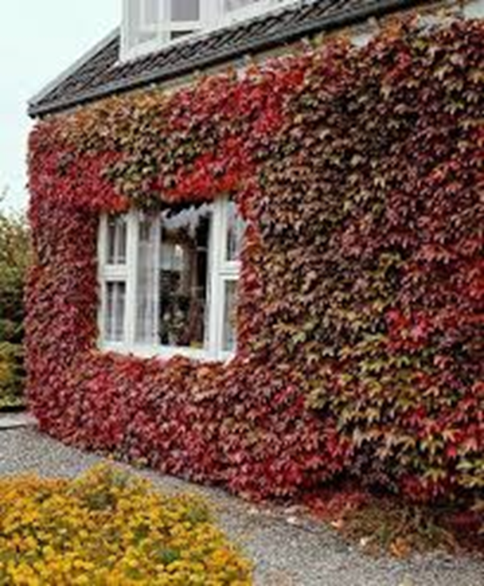
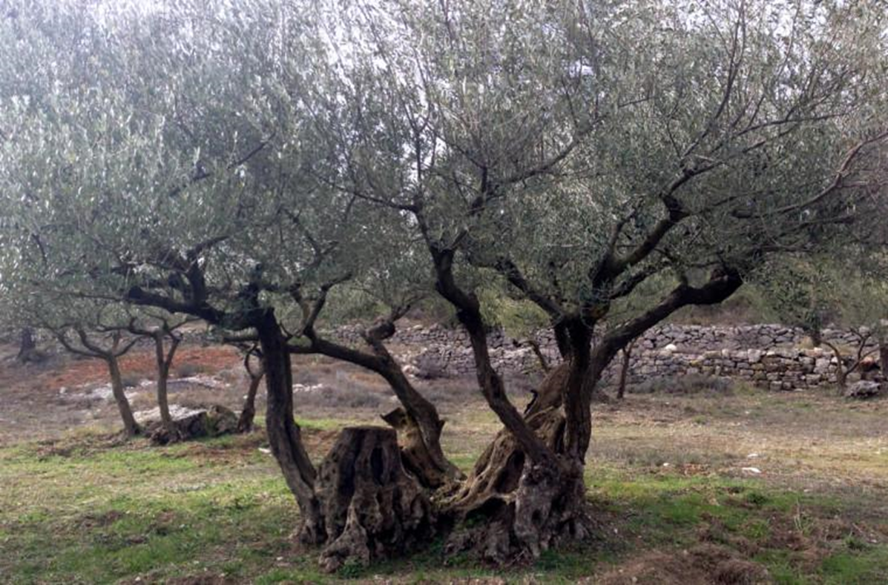
Ps 128:1-6 1 Blessed is everyone who fears the Lord, Who walks in His ways.
2 When you eat the labor of your hands, You shall be happy, and it shall be well with you.
3 Your wife shall be like a fruitful vine In the very heart of your house, Your children like olive plants All around your table.
4 Behold, thus shall the man be blessed Who fears the Lord.
5 The Lord bless you out of Zion, And may you see the good of Jerusalem All the days of your life. 6 Yes, may you see your children's children.

